Slide 1
PLC-BASED TRAFFIC LIGHT CONTROL
Mini Project Using Ladder Logic
Green: 0-7 s | Yellow: 7-9 s | Red: 9-20 s
Presented by: Krishna
PLC Automation Mini Project

Slide 2
1. Problem Statement
• Traffic signals control vehicle movement at road intersections.
• Manual switching is inefficient and may cause human errors.
• A PLC can automate the traffic light sequence using timers.
• The system repeats the sequence continuously.
• A Stop input is provided to stop the demonstration system.
PLC Traffic Light Control

Slide 3
2. Project Objectives
• Understand PLC-based automation.
• Develop a simple Ladder Logic program.
• Control three lamps using digital outputs.
• Use on-delay timers to control signal duration.
• Test the sequence using a PLC simulator.
PLC Traffic Light Control

Slide 4
3. Required Inputs and Outputs
• INPUTS
• I0.0 - Start push button (normally open).
• I0.1 - Stop circuit healthy (normally closed button).
• OUTPUTS
• Q0.0 - Green lamp: GO.
• Q0.1 - Yellow lamp: CAUTION.
• Q0.2 - Red lamp: STOP.
PLC Traffic Light Control

Slide 5
4. PLC I/O Address Table
Device | Address | Function
Start button | I0.0 | Digital input
Stop circuit | I0.1 | Digital input
Green lamp | Q0.0 | Digital output
Yellow lamp | Q0.1 | Digital output
Red lamp | Q0.2 | Digital output
Phase memory | M0.1-M0.3 | Internal bits
Example addresses - adapt to the selected PLC

Slide 6
5. Traffic Light Timing Sequence
• 0-7 seconds: GREEN lamp ON (7 seconds).
• 7-9 seconds: YELLOW lamp ON (2 seconds).
• 9-20 seconds: RED lamp ON (11 seconds).
• At 20 seconds, return to GREEN and repeat.
• Total cycle time = 7 + 2 + 11 = 20 seconds.
• Repeat the Process
PLC Traffic Light Control

Slide 7
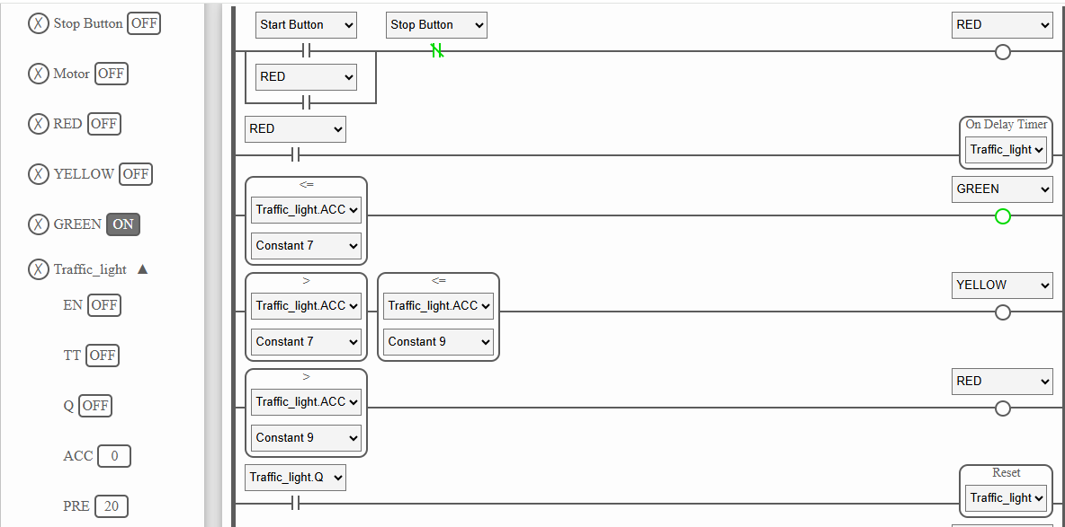
6. Ladder Logic Program
Conceptual Ladder Logic - adapt timer syntax to your PLC

Slide 8
7. Working Principle
1. Press Start to set the system RUN bit.
2. Activate Green and start timer T1 for 7 seconds.
3. When T1 finishes, switch to Yellow for 2 seconds.
4. When T2 finishes, switch to Red for 11 seconds.
5. When T3 finishes, switch back to Green.
6. Repeats the process from start to zero.
PLC Traffic Light Control

Slide 9
8. Simulation and Testing
• Test 1: Press Start - Green lamp turns ON.
• Test 2: At 7 seconds - Yellow lamp turns ON.
• Test 3: At 9 seconds - Red lamp turns ON.
• Test 4: At 20 seconds - Green turns ON again.
• Test 5: Repeat.
PLC Traffic Light Control

Slide 10
9. Expected Result and Conclusion
• Automatic traffic light operation using a PLC.
• Green duration: 7 seconds.
• Yellow duration: 2 seconds.
• Red duration: 11 seconds.
• Continuous cycle duration: 20 seconds.
• The project demonstrates timers, memory bits, inputs, outputs,
• and sequential control using Ladder Logic.
• THANK YOU
PLC Traffic Light Control

